Slide 1
Library Management System
Making job easier for librarian

Slide 2
Guidance:-
Prof. Naresh C. Thoutam

Slide 3
Presented By:
Lucky Nirankari S190614289
Darshil Gajul S190614246
Vasant Pardeshi S190614294
Aayush Shah S190614202

Slide 4
Motivation
Greater accountability and transparency in operations.
Managing the library in well mannered.
Reminding customer of due date as well as fine.
It saves time
Reduces the wastage of materials.

Slide 5
Abstract
A library management system is an application designed to help librarians manage a university library. The system provides a basic feature set for adding / updating members, adding / updating books, and managing check-in specifications for the system based on the needs of other students. This project "LIBRARY MANAGEMENT" provides complete information about the library. You can enter a new book record to get the details of the books available in the library. You can publish a book to your students and keep a record of it. You can also check how many books have been published and are available in the library.

Slide 6
Introduction
A library management system is software designed to manage all the functionality of a library. This helps librarians maintain a database of new books and books borrowed by members over time. This system fully automates all activities in the library.
The modern generation depends on computers and uses software through computers.
Python, you will use Python to create an application to manage your library system. This allows you to save information about the student publishing the book and the student who brought the book from the library. This application is primarily used for library management.

Slide 7
Requirements
Functional requirements:
Book Entry: In this module we can store the details of the books.
Register Student: In this module we can keep the details of the new student.
Book issue: This module is used to keep the track of book issue details.
Book return : This module enables to keep a track of returned books.

Slide 8
System Requirements:
The system should prompt for the user and the admin to login to the application and for proper input criteria.
Hardware & Software Requirements:
Storage : 500GB
RAM : 2GB
Processor : Intel core-i3
Language: Python
Database: SQlite3

Slide 9
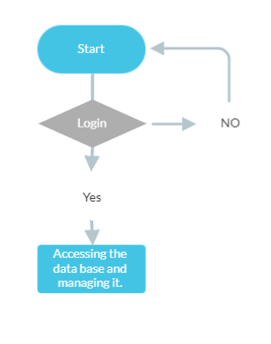
Design

Slide 10
Applications
To store the information of issued books.
To feed information of returned book.
To access information of a particular student.
To retrieves the information of issued and returned books.

Slide 11
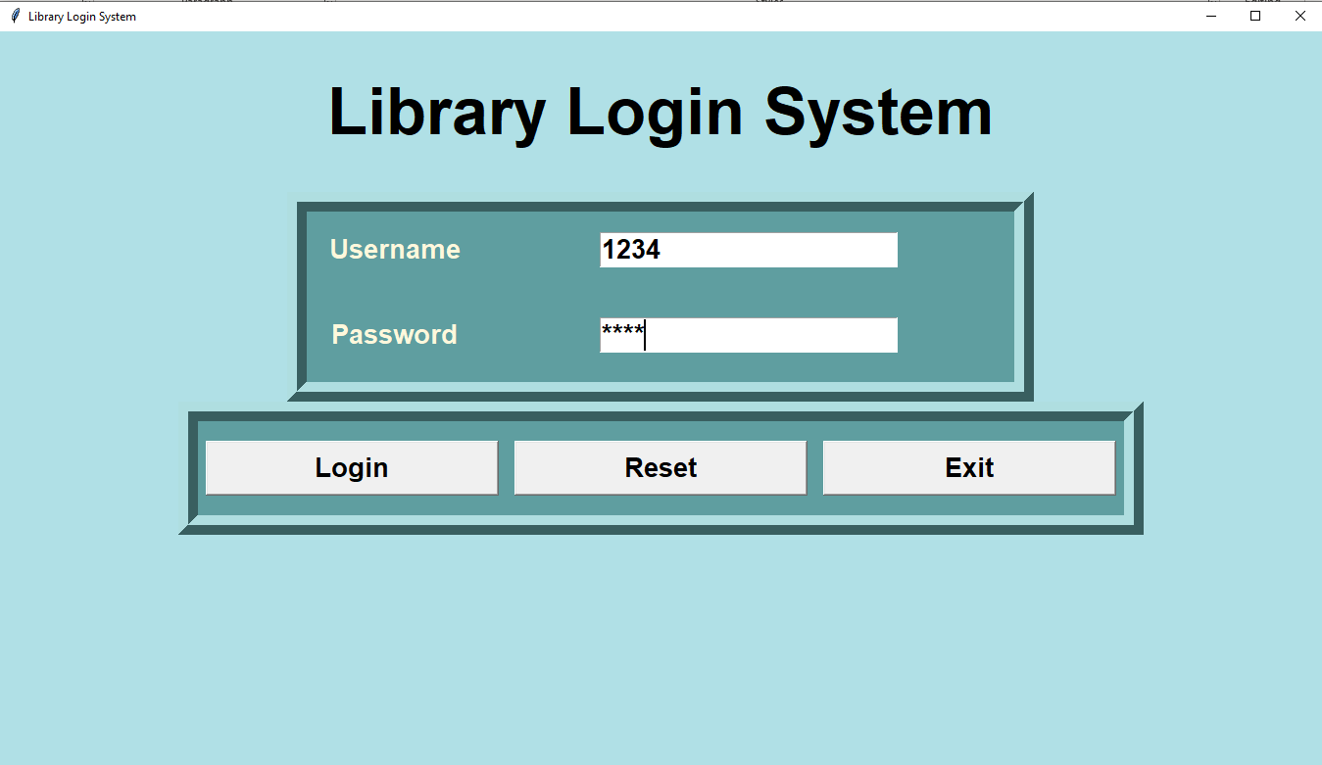
Execution /System Outputs

Slide 12
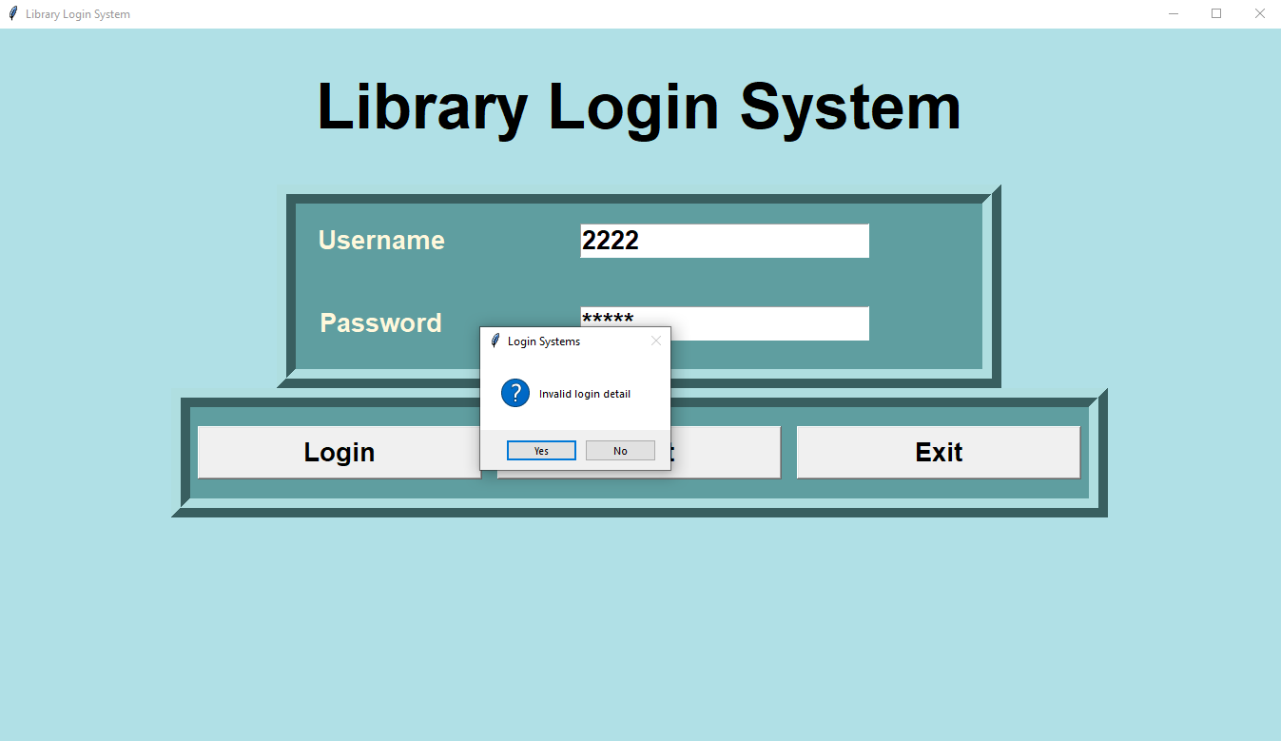
Secured Login

Slide 13
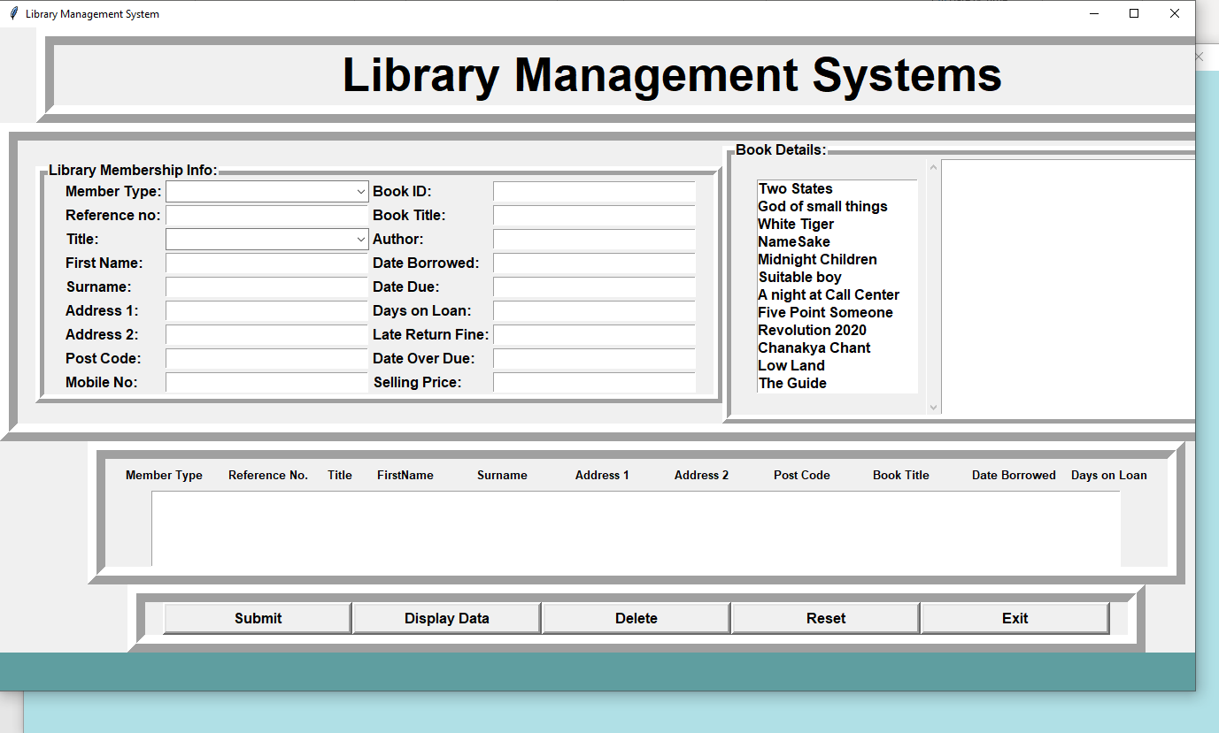

Slide 14
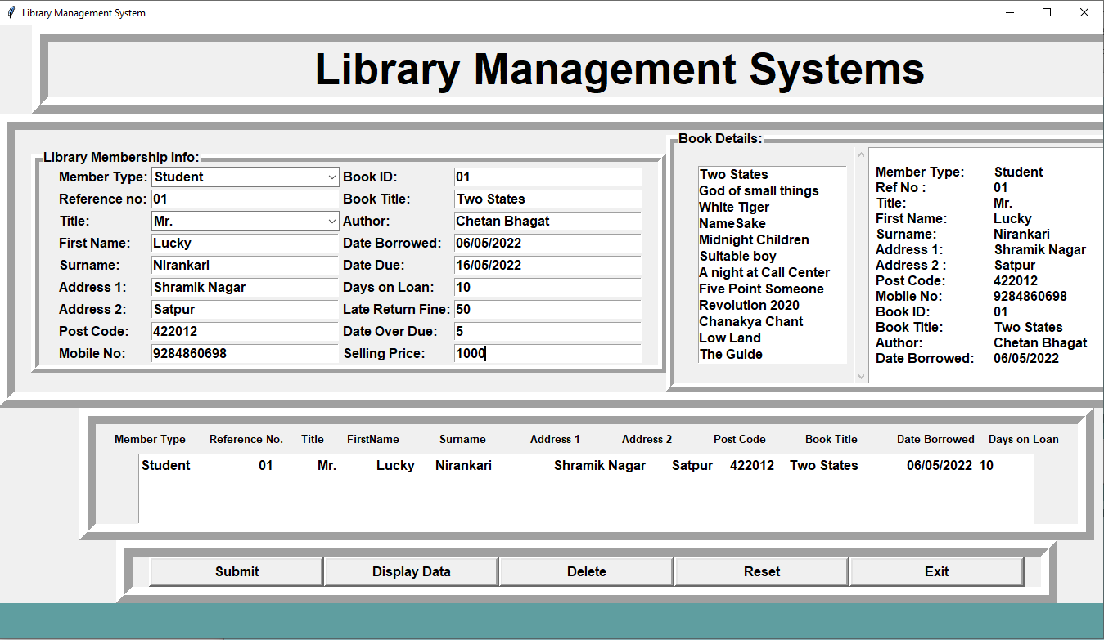

Slide 15
Limitation
The data stored is prone to cyber hacks.
Costly and Expensive.
Risk of computer virus.
Risk of losing data since it is local hosted.

Slide 16
Future Scope
We can store database on cloud services.
To utilize resources in an efficient manner by increasing their productivity through automation.
To keep track digitally of what is available in the library.
Giving Bar code to every book to track the movement of book.
We can make it as E-Library.

Slide 17
Conclusion
In this article, we have successfully developed a Python-based user-interactive database management system that is highly applicable to university libraries. With this software, even users without Python knowledge can easily understand graphical reports of various transactions such as book availability, copies, and fines. Proper security was also maintained so that only authorized users from the administrator could access the service. This software can run on any operating system with a Python virtual machine. From a proper analysis of the good points and limitations, we can conclude that this is a very efficient GUI-based software. This library management system is functioning properly and meets all user requirements of the institution.

Slide 18
References
Python Tkinter documentation
SQlite Documentation
https://docs.python.org/3/
https://docs.python.org/3/library/tk.html

Slide 19
Thank
You

